Slide 1


Slide 2
An embedded system is a special purpose computer system designed to perform one or a few dedicated functions, often with real time computing constraints.
It is usually embedded as part of a complete device including hardware and mechanical parts.

Slide 3
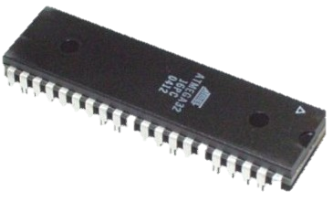
Microcontroller
A microcontroller is a small computer on a single integrated circuit consisting of a relatively simple CPU combined with support functions such as a crystal oscillator, timers, watchdog timer, serial and analog I/O etc.
Microcontrollers are also used in scientific, high technology, and aerospace projects.
Microcontrollers are designed for small or dedicated applications.

Slide 4
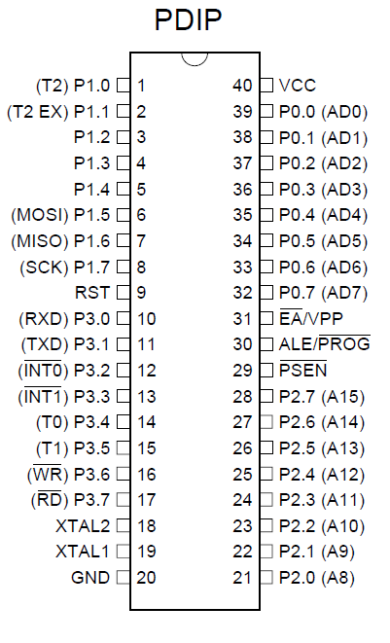
PIN DESCRIPTION

Slide 5
ADVANTAGES OF MICROCONTROLLER`
Low cost
User friendly
Easily available in market
We can reprogram it up to 1000 times
Less power consumption

Slide 6
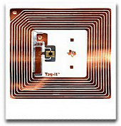
RFID SYSTEM
RFID (Radio Frequency Identification) is a technology that incorporates the use of electromagnetic or electrostatic coupling in the radio frequency (RF) portion of the electromagnetic spectrum to uniquely identify an object.
An RFID system consists of three components: an antenna and transceiver and a transponder. The antenna uses radio frequency waves to transmit a signal that activates the transponder.
When activated, the tag transmits data back to the antenna which is used to notify a programmable logic controller that an action should occur.

Slide 7
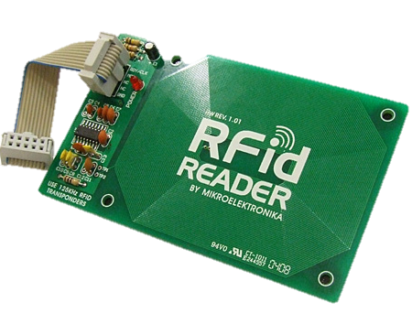
RF READER
The RFID reader sends a pulse of radio energy to the tag and listens for the tag’s response. The tag detects this energy and sends back a response that contains the tag’s serial number and possibly other information as well.
RFID readers are usually on, continually transmitting radio energy and awaiting any tags that enter their field of operation

Slide 8
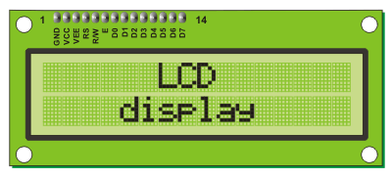
A liquid crystal display (LCD) is a thin, flat panel used for electronically displaying information such as text, images, and moving pictures.
Among its major features are its lightweight construction, its portability, and its ability to be produced in much larger screen sizes than are practical for the construction of cathode ray tube (CRT) display technology.

Slide 9
Pin Description of LCD:
Ground
Vcc +5V
Contrast control
Register select (RS)
Read/Write (RD/WR)
Enable (EN)
7 – 14 pins all are data pins D0 – D7
Vcc +5V }
Ground }
For backlight purpose

Slide 10
MAX-232
The MAX232 is an integrated circuit that converts signals from an RS-232 serial port to signals suitable for use in TTL compatible digital logic circuits.
The MAX232 is a dual driver/receiver and typically converts the RX, TX, CTS and RTS signals.

Slide 11
This project uses regulated 5v, 500mA power supply.
7805, a three terminal voltage regulator is used for voltage regulation.
Bridge type full wave rectifier is used to rectify the ac output of secondary of 230/12v step down transformer.
The RFID module requires a separate +5v power supply.

Slide 12
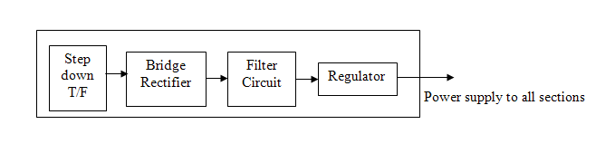
Power supply

Slide 13
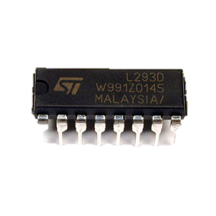
H-Bridge
600 mA Output Current Capability Per Driver
Pulsed Current 1.2 A / Driver
Wide Supply Voltage Range: 4.5 V to 36 V
Separate Input-Logic Supply
NE Package Designed for Heat Sinking
Thermal Shutdown & Internal ESD Protection
High-Noise-Immunity Inputs

Slide 14
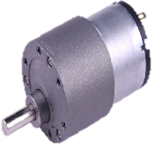
DC-Geared Motor
Technical Specifications:
60RPM 12V DC motors with Metal Gearbox
25000 RPM base motor
38kgcm torque
No-load current = 800 mA(Max)
Load current = upto 9.5 A(Max)

Slide 15
ADVANTAGES OF PROJECT
No manual errors
Fit and forget system
Highly sensitive
Low cost and reliable circuit
Simple Design
Low Maintenance.
By concluding we can surely say this product is a best replaceable for BAR CODE SECURITY SYSTEM.

Slide 16
Conclusion
In this project, we conclude by saying that this can be used for security purpose where it gives information about the authorized persons and unauthorized persons by using a Radio Frequency Identification.

Slide 17


